Slide 1

HarborMaster: Rollback Detection for Trusted Distributed Computing
Shubham Mishra
Alexander Thomas
Nurzhan Abdrassilov
Natacha Crooks
John Kubiatowicz
Notes:
Hi, I am Shubham and today I am going to talk about HarborMaster, a scalable approach to detecting rollback attacks when dealing with a cluster of 10s to 100s of nodes running in Trusted execution environments.

Slide 2



Context: Trusted Execution Environments
Execution integrity
Confidentiality
Notes:
But first let me back up a little bit. What are Trusted Execution Environments?
These are technologies like Intel’s TDX, AMD SEV-SNP and ARM CCA that guarantees: <Click>
Integrity of compute, that is, you get a cryptographic proof that your VM is running what you think it is running
<Click>
And confidentiality of memory!
This allows application developers to deploy confidential computing applications in potentially rogue and untrusted cloud providers.

Slide 3

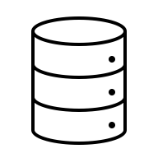


The Evolution of TCB
Notes:
The Trusted Computing Base, or TCB for short, of using TEEs used to be small before.
Usually, a small secure service, like a key manager, ran on a TEE. Others remained in normal VMs or containers.

Slide 4
The Evolution of TCB
Notes:
But with the advent of VM-based TEEs, like AMD SEV, applications are moving to using Trusted Execution for all services!

Slide 5
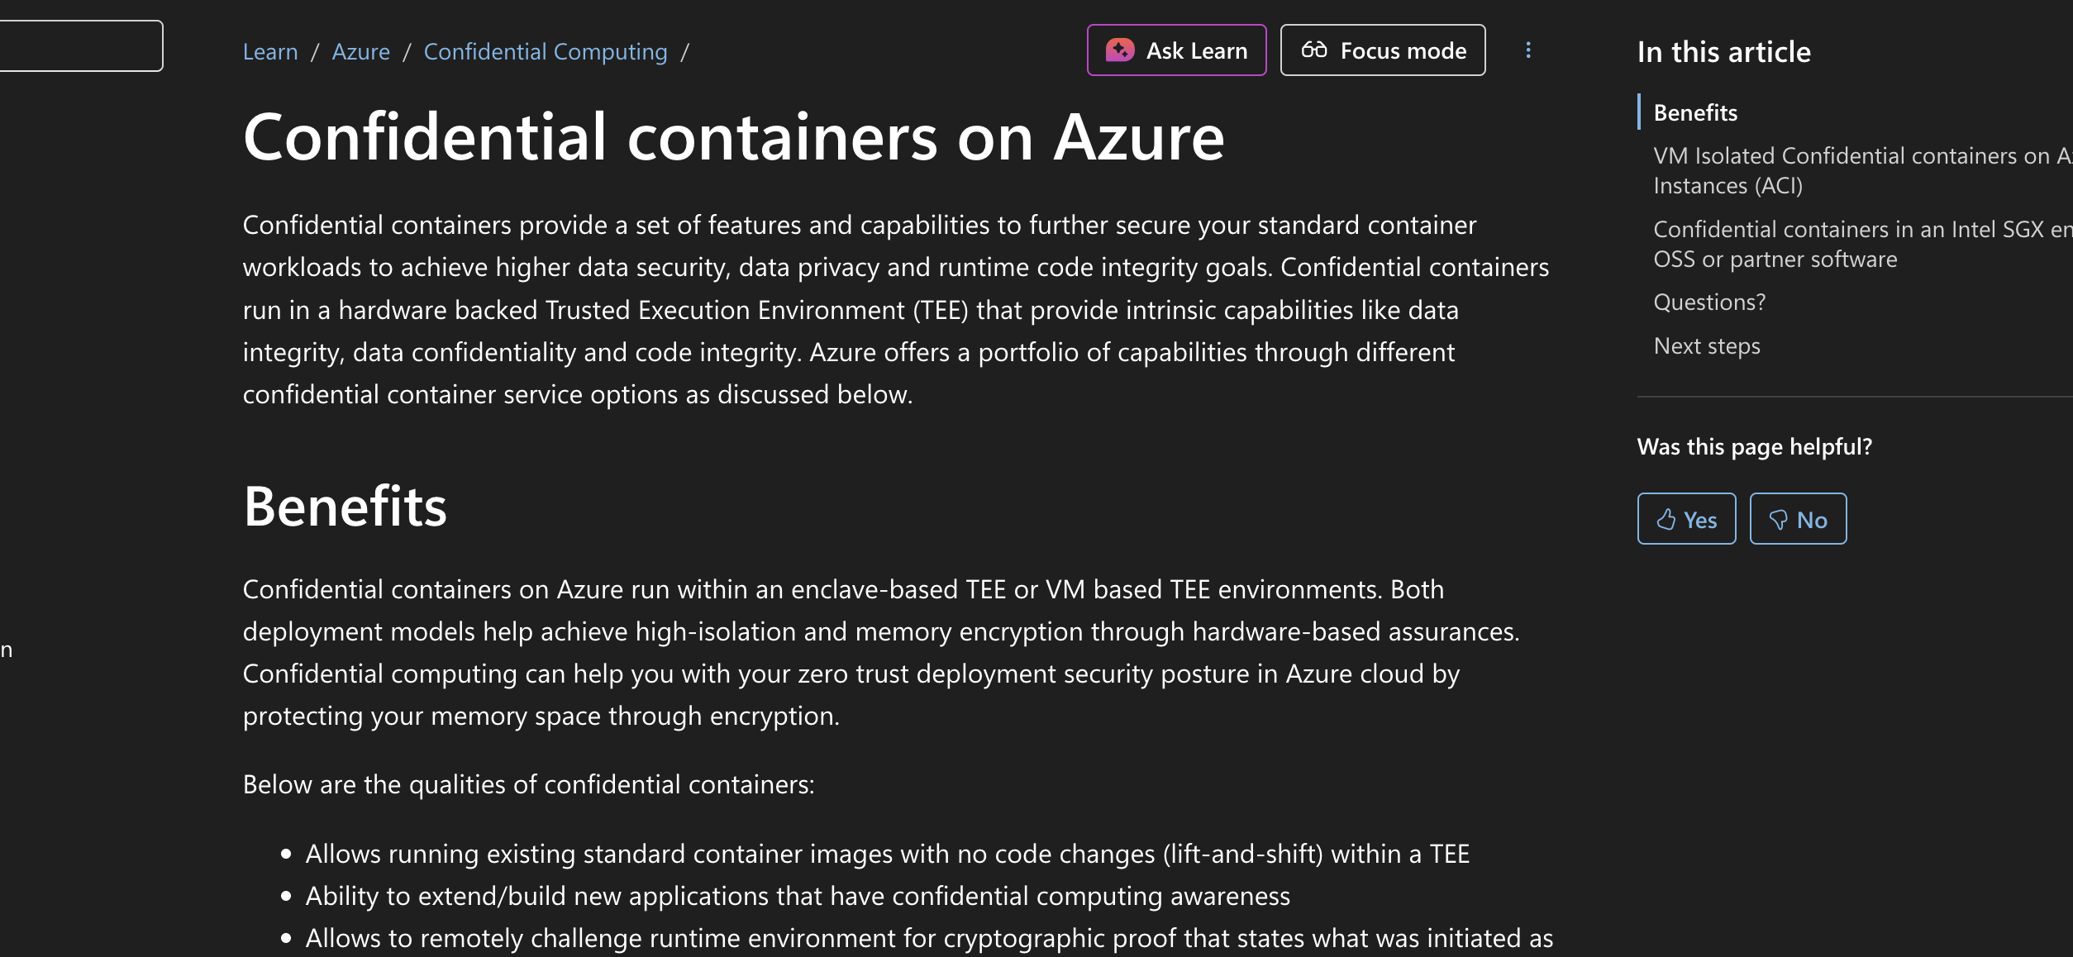

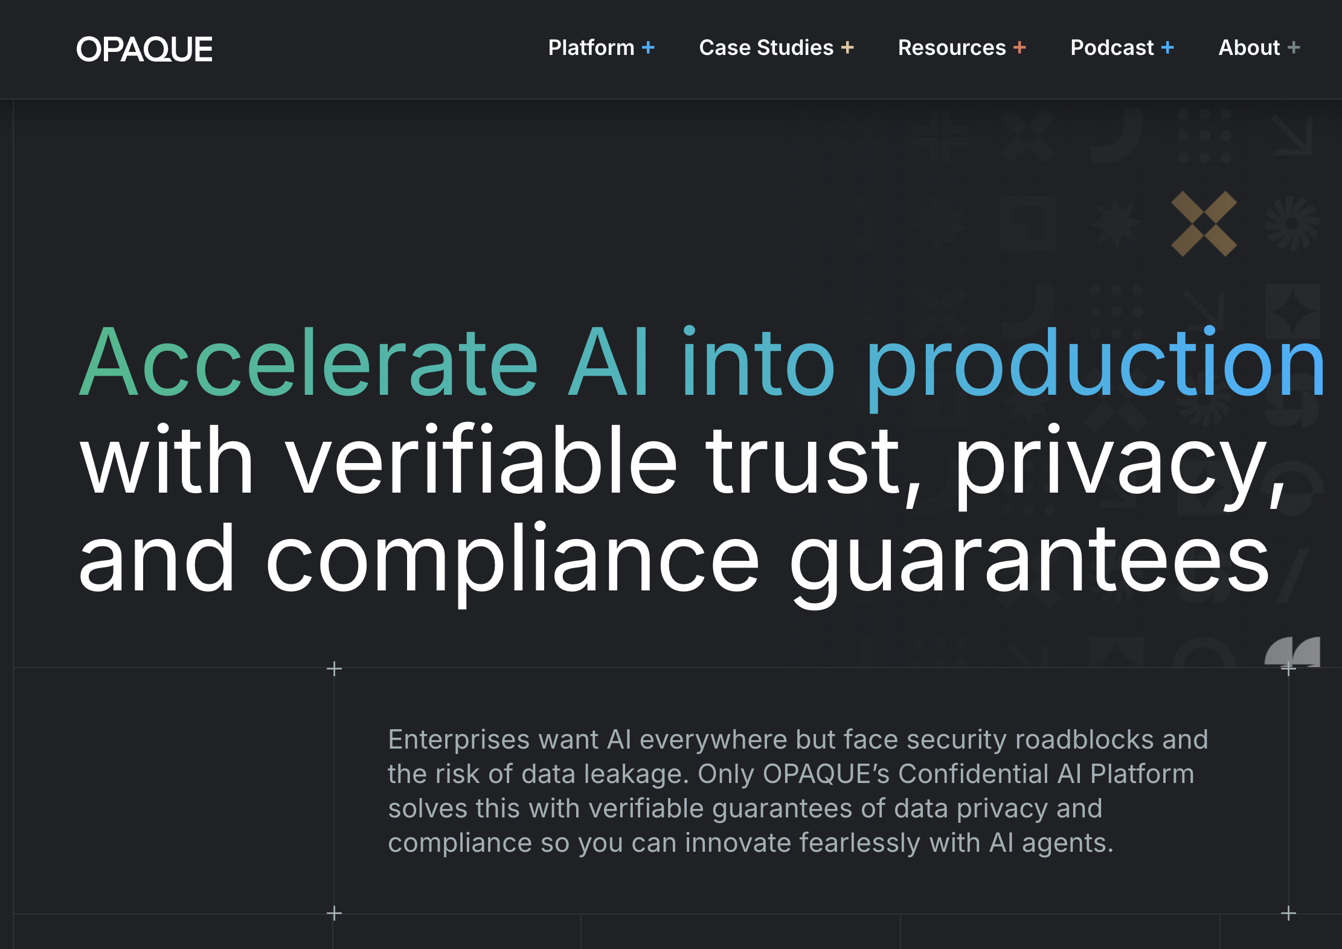
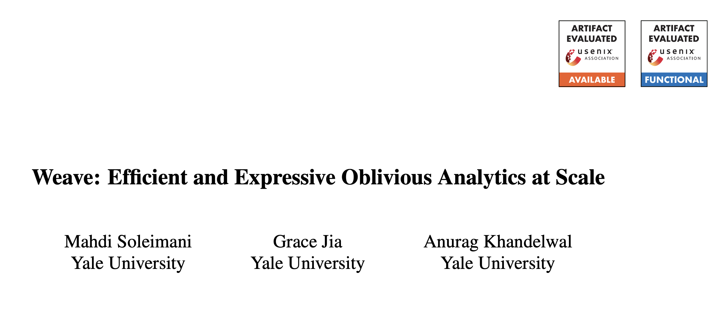
The Evolution of TCB
Notes:
TEE based clusters are quickly becoming commonplace.
This is evident from new cloud offerings like Azure Confidential Container fleets.
<Clicks> Companies like Edgeless and Opaque
<Click>
And academic papers.

Slide 6
There’s one big problem!
TEEs do not protect persistent storage!
Notes:
But there is one big problem!
TEEs do not protect against persistent storage.
TEE – based systems are vulnerable to rollback attacks.

Slide 7

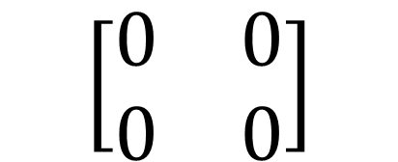
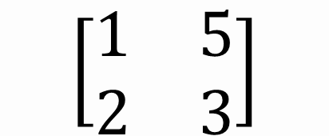
Rollback Attacks
$$\left[\begin{matrix}1 & 5 \\ 2 & 3\end{matrix}\right]$$
$$\left[\begin{matrix}0 & 0 \\ 0 & 0\end{matrix}\right]$$
Model
Checkpoint
Notes:
What do I mean by that?
Say you are running a ML training job in a TEE.
<Click>
And after sometime, you save a checkpoint in your disk.

Slide 8
Rollback Attacks
$$\left[\begin{matrix}1 & 5 \\ 2 & 3\end{matrix}\right]$$
$$\left[\begin{matrix}0 & 0 \\ 0 & 0\end{matrix}\right]$$
Notes:
Then your VM crashes.
<Click> A rogue cloud provider can then come and rollback your disk to an older state.

Slide 9
Rollback Attacks
$$\left[\begin{matrix}0 & 0 \\ 0 & 0\end{matrix}\right]$$
🤔
Notes:
When the VM boots back up and tries to read the most recent checkpoint, it is fed an older checkpoint.
And your training code won’t know any better.

Slide 10

Rollback Attacks
Latest Greatest GPT
Latest Greatest GPT
Latest Greatest GPT
Notes:
The problem is even more insidious in a cluster setting.
Say a training service pushes a new version of a model to 3 inference workers.
Afterwards, it declares to the clients that the new model is available.

Slide 11
Rollback Attacks
?
🤔
Notes:
Say one of the workers gets rolled back.
<Click> And a user interacts with it later on.
It will interact with the older version of the model.

Slide 12
Rollback Detection
Durable Logging is necessary!
Notes:
What can we do to detect this?
<Click> As it turns, the key to detection is in durably logging read and write requests and responses from all the services. So that an audit trail remains to detect misbehaviors later on.
When it comes to logging, there are currently 2 ways people do it.

Slide 13
The Single-Log Approach
1
2
Latest Greatest GPT
Client Access
Client Access
1
2
Notes:
The first is a single log approach, where we use a distributed trust system to realize a totally ordered log <Click>
and commit log entries corresponding to read and write events in it.

Slide 14

The Single-Log Approach
1
🤔
2
Latest Greatest GPT
Client Access
Client Access
1
2
Notes:
Later on, an auditor can simply look at this log and say
“Hmm…., the training service committed this latest model, but this worker used an older model to answer the client request”
This must mean there has been a rollback attack.

Slide 15
The Single-Log Approach
One log: easy to audit.
But very high coordination overhead.
Operations can’t run in parallel, must be serialized.
Notes:
Single-log has its pros and cons.
<Read the slide>

Slide 16
The Multi-Log Approach
Latest Greatest GPT
Latest Greatest GPT
Client Access
1
1
Latest Greatest GPT
Client Access
2
2
Notes:
On the other hand, there is the multi-log approach.
Instead of having a single log every service must coordinate to write to,
Each service has its own log.
However, in order to have meaningful semantics, they must independently log every event they see.
So this log entry for seeing a new model, must be committed by both the training service and the inference containers.

Slide 17
The Multi-Log Approach
No Coordination Overhead.
But prone to high write amplification!
Notes:
So we traded coordination overhead for high write amplification!

Slide 18
Can we do better?
Notes:
Can we do better? <pause> Turns out we can!
We looked into what is necessary for detecting rollback attacks, and arrive at this truly simple insight. <Next slide>

Slide 19
Insight
Rollback Attack $⇒$Violation of Causality
Notes:
<Slow down here>
Rollback Attacks, especially the ones that cause harm by outputting ”wrong” data, effectively show up as a violation of causality somewhere in the cluster!

Slide 20
Insight
Latest Greatest GPT
Happened Before
Latest Greatest GPT
Client Access
1
1
Happened Before
Latest Greatest GPT
Client Access
2
2
Notes:
Let’s understand this better, what are these logs establishing?
It is nothing but a happens before relationship among these read and write events.

Slide 21
Insight
Latest Greatest GPT
Is the recorded response consistent with all events that happened before it?
Happened Before
Latest Greatest GPT
Client Access
1
1
Happened Before
🤔
Latest Greatest GPT
Client Access
2
2
Notes:
The auditing service simply checks if the recorded response for a read request is consistent with all the events that happened before it.

Slide 22
Causal Logging: Vector Clocks
Latest Greatest GPT
Client Access
1
1
<1, 0, 0>
🤔
Client Access
2
2
<1, 0, 0>
Notes:
We therefore, rely on more than 30–years worth of research in causal logging to have a low overhead logging system without paying the cost of coordination or write amplification.
For these in the know, we simply use a Vector clocks to refer to the causal history of log entries and help the auditor re-create the state of a node to audit the read log entries.

Slide 23

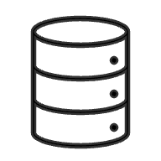



HarborMaster Architecture
Worker Nodes
Latest Log Entries
Persisted Hash Chains
Storage Servers
Application Logic
Clients
Application State
Recreated Worker State
Persistent State
Auditor
Auditing Logic
TEE-protected
In-Memory State
Distributed Application Cluster
HarborMaster Infrastructure
Notes:
We built HarborMaster around this simple idea, intended to provide rollback detection as a service.
In the interest of time, I won’t go into more details, but I will leave you with the main challenge we had to solve: How do I durably store these log entries when the disks that store these entries can all be rolled back!

Slide 24
Pick your poison antidote!
HarborMaster-lite
HarborMaster-core
Just the logging and auditing infrastructure.
Suitable for lifting-and-shifting existing applications.
Also includes an eventually consistent distributed KV store.
New applications can abstract away the details of causal logging.
Notes:
There are two variants of HarborMaster.
<Click> You can use the lite version to easily integrate the logging and auditing service to your existing cluster.
<Click> Or, if you are building a new application, you can use our core version that gives you distributed KV store and abstracts away all logging behind it.

Slide 25
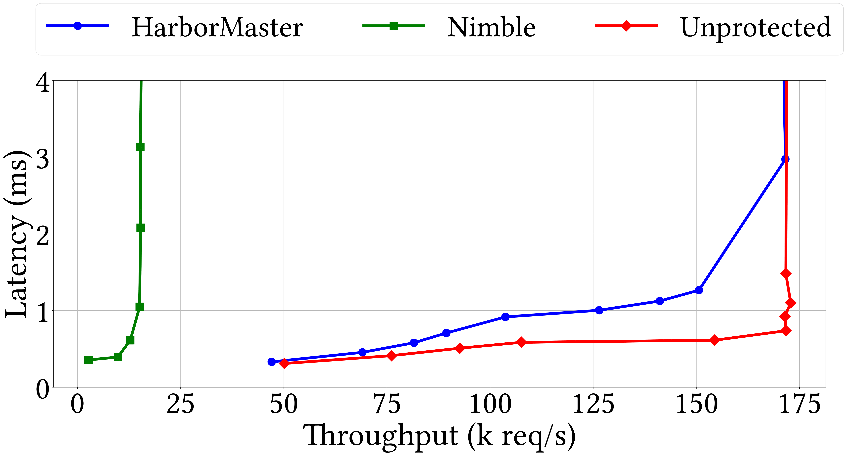
Evaluation
Notes:
In the remaining time, let’s quickly go over some performance numbers.
Here we use a 16 node cluster running a YCSB workload and benchmark HarborMaster against an unprotected baseline and Nimble, a state of the art single log solution.
Nimble doesn’t scale well due to coordination overhead.
But HarborMaster only imposes a 12% drop in throughput before saturation.

Slide 26
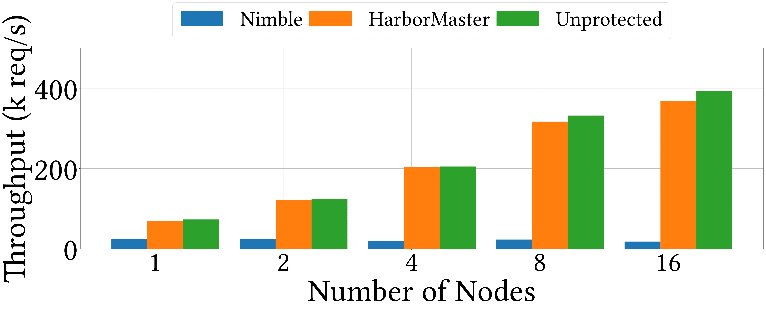
Evaluation
Notes:
We now examine how these different approaches scale with number of nodes.
We do this in a key transparency setting where each node is generating new keys for users and
We see that HarborMaster scales linearly similar to the unprotected baseline, but the single-log implementation doesn’t scale beyond the 1 node setup, because of the coordination overhead.

Slide 27
Thank you!
Rollback Attack $⇒$Violation of Causality
<shubham_mishra@berkeley.edu>
Find me during poster session tomorrow!

